Slide 1
Using the Dapr Proxy for Service Invocation
By George Stevens
Software Architect at Solid Value Software
For the 12/23/22 General Public

Slide 2
Intellectual Property Notice
Licensed under the Apache License, Version 2.0 (the "License"); you may not use this slide deck except in compliance with the License. You may obtain a copy of the License at http://www.apache.org/licenses/LICENSE-2.0
Unless required by applicable law or agreed to in writing, software and slides distributed under the License is distributed on an "AS IS" BASIS, WITHOUT WARRANTIES OR CONDITIONS OF ANY KIND, either express or implied.
See the License for the specific language governing permissions and limitations under the License.
Copyright © 2022 Solid Value Software, LLC

Slide 3
Warning – Construction Zone
The slides for this project are currently being made.
The slides currently contained in the slide deck are for the code in the grpc-pubsub-azservicebus folder of this repo, which is about the Dapr Mesh.

Slide 4
The Dapr-Mesh
A shortened term for a “Dapr Mesh-of-Services”.
A collection of collaborating services all using Dapr sidecars within a “nearby network neighborhood” as diagrammed in the below generalized Dapr-Mesh:
Service A
Service B
…..
Service N
Http or gRPC
Dapr
Sidecar A
Dapr
Sidecar B
…..
Dapr
Sidecar N
gRPC Only

Slide 5
Thinking outside the Dapr-Mesh
3 ways to think “outside the Dapr-Mesh”:
1. Think at a high conceptual level above the Dapr-Mesh about WHAT the services do and WHAT collaborations they have with each other.
Ignore the technical details. Ignore Dapr, hosting, technology.
Hide the details to discover key aspects of your design that may otherwise be obscured by a myriad of technical details.
The result -- A Logical Diagram of your services and the utilities they use. And of our code sample.
Test Client
With a UI
The dashed line arrow style, meaning reliable messaging, is taken from Righting Software by Juval Lowy, Copyright 2020, p 119.
ServiceA
Pub/Sub
ServiceB

Slide 6
Thinking outside the Dapr-Mesh
2. Look at the communications with services and resources EXTERNAL to your Dapr-Mesh.
When considering communications with external services that you develop ask:
Do I need another Dapr-Mesh to contain some or all the external services under my control?
Using multiple interconnected Dapr-Meshes is useful when:
Services are geographically separate and beyond the “nearby network neighborhood” of a given Dapr-Mesh.
And when one Dapr-Mesh becomes so filled with services, and their communications with each other, that it becomes unmanageable.

Slide 7
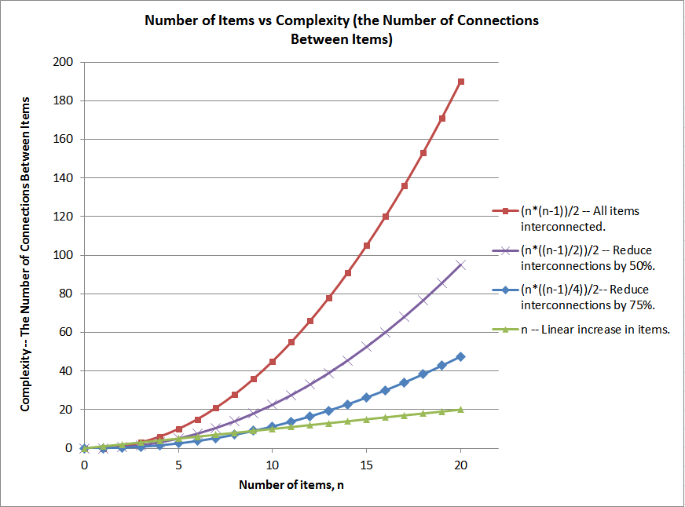
What is unmanageable? Mathematics behind the non-linear expansion of complexity of software and thus the non-linear expansion of the amount of work required.
Copyright © 2017 by George Stevens. All rights reserved.

Slide 8
Multiple interconnected Dapr-Meshes
Use a high level abstraction diagram of a Dapr-Mesh to hide the minute details of what is going within each collaborating Dapr-Mesh.
You will more easily see the Big Picture: A Mesh-of-Dapr-Meshes.
#2
Dapr-Mesh
#3
Dapr-Mesh
#N
Dapr-Mesh
Services
Services
Services
…..
Dapr
Sidecars
Dapr
Sidecars
Dapr
Sidecars
#1
Dapr-Mesh
Services
Dapr
Sidecars
External Messaging Backbone for Pub/Sub

Slide 9
Thinking outside the Dapr-Mesh
3. View a Dapr-Mesh as a higher order Building Block to create a Mesh-of-Dapr-Meshes
Compose Dapr-Meshes from services and components.
Then compose Meshes-of-Dapr-Meshes from Dapr-Meshes and their specialized components.
This maintains Dapr’s excellent separation of concerns, component orientation, and composibility.
A specific Dapr-Mesh Component can be reused in multiple places in a software system, just as can a service or a normal Dapr Component.

Slide 10
Dapr-Mesh diagram of the previous Logical Diagram of our sample code
It uses a single external-from-mesh communication resource – A Dapr pubsub.azure.servicebus type of component.
What it looks like when the Test Client & all Services are running on the same machine.
Test Client
With a UI
ServiceA
ServiceB
…..
Service N
Http or gRPC
Dapr
Sidecar A
Dapr
Sidecar B
…..
Dapr
Sidecar N
Test Client
With a UI
gRPC Only
ServiceA
Pub/Sub
ServiceB
Azure SB
Pub/Sub
Previous Logical Diagram

Slide 11
When ServiceB is geographically separate from ServiceA
Now we need 2 Dapr-Meshes using the same Pub/Sub. And this requires NO CODE CHANGES.
Happens when Test Client and ServiceA run on one machine, with ServiceB running on another machine.
Test Client
With a UI
Dapr-Mesh A
Dapr-Mesh B
ServiceA
…..
Service N
ServiceB
…..
Service N
Http or gRPC
Http or gRPC
Dapr
Sidecar A
…..
Dapr
Sidecar N
Dapr
Sidecar B
…..
Dapr
Sidecar N
gRPC Only
gRPC Only
Azure SB
Pub/Sub

Slide 12
Geographically separated services are a recurring topic on Dapr-Discord
I want a service running on some VM at the edge to communicate with services in a Dapr-Mesh in the cloud or an on-prem data center.
This scenario most likely needs 2 Dapr-Meshes.
Geographical separation of services is also a common topic in the world of IoT.
Devices, field and protocol gateways, and cloud providers are often in different places.
This scenario will likely require multiple Dapr-Meshes.

Slide 13
The Trans Dapr-Mesh Gateway is Needed in a Mesh-of-Dapr-Meshes
The Trans Dapr-Mesh Gateway (TDMG) is a component of the Dapr-Mesh.
It enables communication between Dapr-Meshes in at least the following areas:
Service Discovery for sending messages to services in other Dapr-Meshes, plus capability to actually send the message.
Dispatching and Event/Message Mapping to service operations local to the receiving Dapr-Mesh.
Security above that within a Dapr-Mesh since communication is across the public internet, including message encryption.
Other? TBD

Slide 14
The Trans Dapr-Mesh Gateway – Now and In the Future
Now -- A TDMG must written by a developer as a Service within a Dapr-Mesh.
When more mature, Dapr can make this a pluggable component configured and attached to a Dapr-Mesh via yaml.
Next -- The code sample. It shows a sketch of parts of a developer-written TDMG.
Now – Dev written TDMG service
Some
Dapr-Mesh
Future – TDMG is a Dapr-Mesh component
Some
Dapr-Mesh
Services
TDM
Gtwy
Services
Some
Dapr-Mesh
Dapr
Sidecars
Dapr
Sidecars
Side
car
Some
Dapr-Mesh
Services
TDM
Gtwy
Services
Dapr
Sidecars
Side
car
Dapr
Sidecars

Slide 15
A quick run through the code sample
The code sample of ServiceA, ServiceB, and the Test Client
It uses Visual Studio, C# ASP.NET Core gRPC Services, Azure Service Bus Topic, and Dapr.
This code is VERY SIMPLE since there is no business logic. Rather there is only a operational Code Skeleton.
The Test Client also functions as a load tester. With a few code changes it is a destructo stress tester as well. This “shifts left” integration testing into dev.
The code sample is posted on my GitHub account in the repo https://github.com/georgestevens99/DiscoverDapr
In the folder named grpc-pubsub-azservicebus
This PowerPoint slide deck is posted there also, as are the following.
The InstallMe installation instructions. These are a work-in-progress and may not be present for a week or so.
The ReadMe document, containing project overview text. Also a work-in-progress for a few days.
Thanks for your participation in this presentation!

